Slide 1
Theme 8. Metrics

Slide 2


Signal-to-noise ratio (SNR)
A signal-to-noise ratio compares a level of signal power to a level of noise power
where A is root mean square (RMS) amplitude
It's most often expressed as a measurement of decibels (dB), because many signals have a very wide dynamic range, and it’s more useful to express it using the logarithmic decibel scale
Higher numbers generally mean a better specification since there's more useful information (the signal) than unwanted data (the noise).
For example, when an audio component lists a signal-to-noise ratio of 100 dB, it means that the audio signal level is 100 dB higher than the noise level. Therefore, a signal-to-noise ratio specification of 100 dB is considerably better than one that is 70 dB or less.

Slide 3
Why Signal-to-Noise Ratio Is Important
You can find specifications for signal-to-noise ratio can in many products that deal with audio, including speakers, telephones (wireless or otherwise), headphones, microphones, amplifiers, receivers, turntables, radios, CD/DVD/media players, PC sound cards, smartphones, tablets, and more. However, not all manufacturers make this value readily known.
The actual noise is often characterized as a white or electronic hiss or static or a low or vibrating hum. Crank the volume of speakers all the way up while nothing is playing; if you hear a hiss, that's the noise, which is often referred to as a "noise floor." This noise floor is always there.
As long as the incoming signal is strong and well above the noise floor, the audio will maintain a higher quality, which is the kind of signal-to-noise ratio preferred for a clear and accurate sound.

Slide 4
Volume and SNR
If a signal happens to be weak, you might think you need to increase the volume to boost the output. Unfortunately, adjusting the volume up and down affects both the noise floor and the signal. The music may get louder, but so will the underlying noise. You would have to boost only the signal strength of the source to achieve the desired effect. Some devices feature hardware or software elements that are designed to improve the signal-to-noise ratio.
Unfortunately, all components, even cables, add some level of noise to an audio signal. The best components are designed to keep the noise floor as low as possible to maximize the ratio. Analog devices, such as amplifiers and turntables generally have a lower signal-to-noise ratio than digital devices.

Slide 5
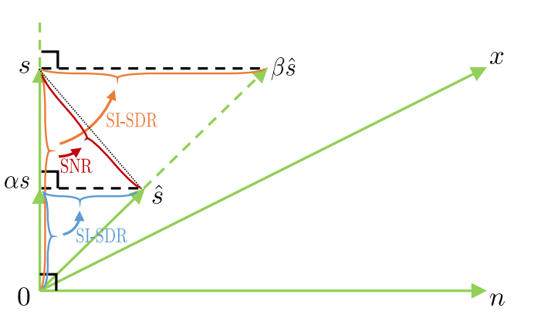


Signal-to-distortion ratio (SDR)
It’s ALMOST equal to SNR, but generally speaking, distortion != noise
Let us consider a mixture x = s + n ∈ R^{L} of a target signal s and an interference signal. Let ŝ denote an estimate of the target obtained by some algorithm.
For simplicity we consider the case where the estimate is in the subspace spanned by speech and noise (i.e., no artifact), what is considered as the noise in such a context is the residual s − ŝ, which is not guaranteed to be orthogonal to the target s.
A tempting mistake is to artificially boost the SNR value without changing anything perceptually by rescaling the estimate, for example to the orthogonal projection of s on the line spanned by ŝ: this leads to a right triangle whose hypotenuse is s, so SNR could always be made positive.
In particular, starting from a mixture x where s and n are orthogonal signals with equal power, so with an SNR of 0 dB, projecting s orthogonally onto the line spanned by x corresponds to rescaling the mixture to x/2: this “improves” SNR by 3 dB

Slide 6
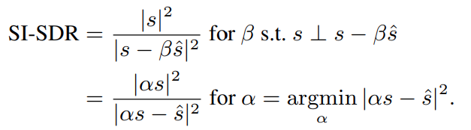
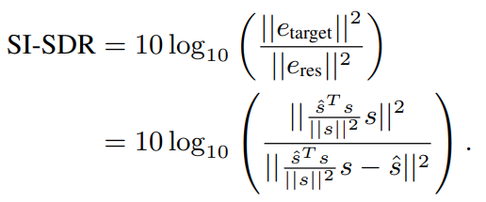
Scale-aware SDR
To ensure that the residual is indeed orthogonal to the target, we can either rescale the target or rescale the estimate.
Rescaling the target such that the residual is orthogonal to it corresponds to finding the orthogonal projection of the estimate ŝ on the line spanned by the target s, or equivalently finding the closest point to ŝ along that line.
This leads to two equivalent definitions for what we call the scale-invariant signal-to-distortion ratio (SI-SDR)
The optimal scaling factor for the target is obtained as α = ŝ^{T}s/||s||² , and the scaled reference is defined as e_{target} = αs. We then decompose the estimate ŝ as ŝ = e_{target} + e_{res}, leading to the expanded formula:
Computation of SI-SDR is thus straightforward and much faster than that of SDR. Note that SI-SDR corresponds to the SDR. SI-SDR has recently been used as an objective measure in the time domain to train deep learning models for source separation, outperforming least-squares on some tasks

Slide 7

Bark spectral distortion (BSD)
Essentially the first objective measure to incorporate psychoacoustic responses
The BSD measure is based on the assumption that speech quality is directly related to speech loudness, which is a psychoacoustical term defined as the magnitude of auditory sensation.
In order to calculate loudness, the speech signal is processed using the results of psychoacoustic measurements, which include critical band analysis, equal-loudness preemphasis, and intensity-loudness power law.
BSD estimates the overall distortion by using the average Euclidean distance between loudness vectors of the reference and of the distorted speech.
When BSD was used initially, the non-silence portions composed of voiced and unvoiced regions were processed. It was found that its performance was enhanced when only the voiced portions are considered in the estimation of distortion. Later versions of the algorithm processed only voiced segments.
First, a nonlinear frequency transformation from Hertz, f, to bark, b, is made via the relation
which transforms the original power spectral density function X(f) to a critical band density function Y(b). The function Y(b) is smeared by a prototype critical band filter F(b) given by
with 𝝰 = 0.215

Slide 8
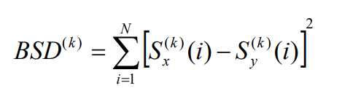


Bark spectral distortion (BSD)
The smearing is conceived of as a convolution operation between F(b) and Y(b) which yields a continuous spectrum D(b).
The equal loudness level curves have been used to translate the sound pressure level (SPL) in dB to loudness levels in phons.
The increase of approximately 10 phons of loudness level is required to make the subjective loudness double for the loudness level greater than 40 phons.
A phon-to-sone conversion is performed to generate a Bark spectrum S(i). Then, the BSD measure is defined as the average of BSD^{(k)} with
where N is the number of critical bands, and and are the Bark Spectra in the i-th critical band for the k-th frame corresponding to the original and the distorted speech, respectively.

Slide 9
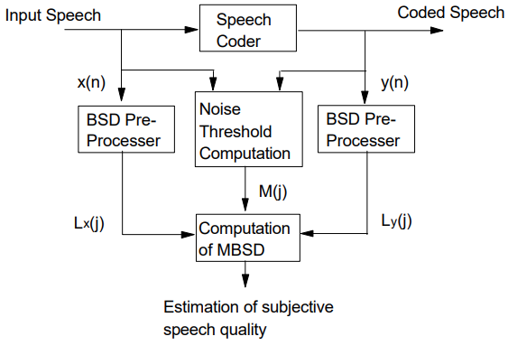
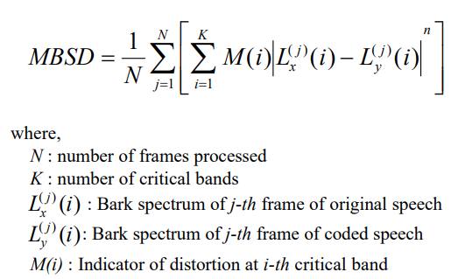
Modified Bark spectral distortion (MBSD)
Motivated by the transform coding of audio signals which uses the noise masking threshold, the concept of a noise masking threshold was incorporated into the conventional BSD measure, where any distortion below the noise masking threshold is not included in the BSD measure.
This new addition of the noise threshold replaces the empirically derived distortion threshold value used in the conventional BSD. The concept of a noise masking threshold was also used to improve speech quality
The noise masking threshold is estimated by critical band analysis, spreading function application and absolute threshold consideration. This noise masking threshold estimation considers tone-masking noise and noise-masking tone. The loudness of the noise masking threshold is compared to the loudness difference of the original and the coded speech to determine if the distortion is perceptible
Indicator of perceptible distortion is denoted by M(i) where, i is the i-th critical band. When the distortion is perceptible, M(i) is 1, otherwise M(i) is 0. Imperceptible distortion is excluded in the MBSD calculation by multiplying M(i) because M(i) is zero when the distortion is not perceptible. So, MBSD value can be defined as the average difference of estimated loudness which is only perceptible.

Slide 10
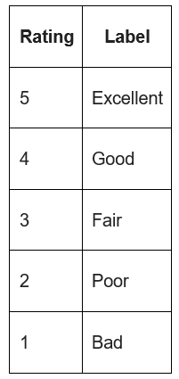

Mean Opinion Score (MOS)
Mean Opinion Score (average score of speech intelligibility) is a value used in QoE and telecommunications. Represents the overall quality of the system. This is the arithmetic average between individual values ​​on a certain scale, given by experts in their own opinion about the quality of the system.
MOS is a widely used metric for evaluating the quality of video, audio and audiovisual content, but is not limited to them. ITU T defines several ways to specify MOS depending on what it will be used for.
MOS is expressed as a rational number, typically ranging from 1 to 5, where 1 is the lowest perceived quality and 5 is the highest. Other MOS ranges are possible, depending on the rating scale used in the respective tests. The most commonly used scale of absolute categories, marked from "poor" to "excellent"
MOS is expressed as the arithmetic mean between individual ratings given by experts to the test sample in a subjective quality assessment:
where R are individual ratings given by N experts.

Slide 11
Mean Opinion Score (MOS)
In general, there is an ongoing debate about the usefulness of MOS as a single scalar QoE measure. Since MOS is obtained using categorical rating scales. This is a psychometric scale that is often used in questionnaires and questionnaire surveys.
When working with the scale, the subject evaluates the degree of his agreement or disagreement with each judgment, from “strongly agree” to “strongly disagree”. In this case, the ranking of scale elements is known, but the interval between them is unknown. Thus, it is mathematically incorrect to calculate the average between individual scores to obtain an average trend, you need to use the median. Despite this, in practice and in the definition of MOS, it is considered acceptable to calculate the arithmetic average.
For categorical rating scales, individual elements are not perceived as equidistant from each other. For example, there may be a wider gap between Good and Fair than between Good and Excellent. The perceived gap may also depend on the language into which the scale is translated.

Slide 12
Mean Opinion Score (MOS)
Some other dependencies come from the way MOS is scoring. In addition to the problems with non-linear scale perception mentioned above, there is a so-called "equalizing bias": experts in the process of subjective experimentation tend to evaluate in such a way as to cover the entire scale. This makes it impossible to compare two different subjective tests with different scales. In other words, MOS is not an absolute measure of quality - only relative to the test in which it is set.
MOS historically comes from subjective measurements, in which listeners sit in a quiet room and evaluate the quality of phone calls as they perceive it. This test methodology has been used in telephony for decades and has been standardized by the ITU in Recommendation P.800. It specifies that the speaker should sit in a quiet room with a volume between 30 and 120 dB and a reverberation time of less than 500 ms (preferably in the range of 200-300 ms). The noise level in the room should be below 30 dBA without pronounced peaks in the spectrum.

Slide 13
Perceptual evaluation of speech quality (PESQ)
PESQ is a family of standards that includes a test methodology for automatically assessing the quality of speech perceived by the receiving end of a transmission system.
PESQ compares the original signal X(t) with the output of the algorithm processing this signal Y(t). The PESQ output is a prediction of the perceived quality that people would give in subjective testing.

Slide 14
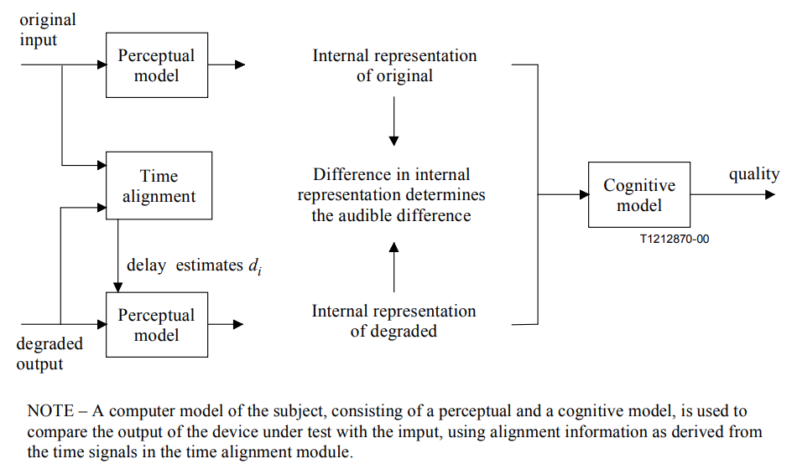
Perceptual evaluation of speech quality (PESQ)

Slide 15
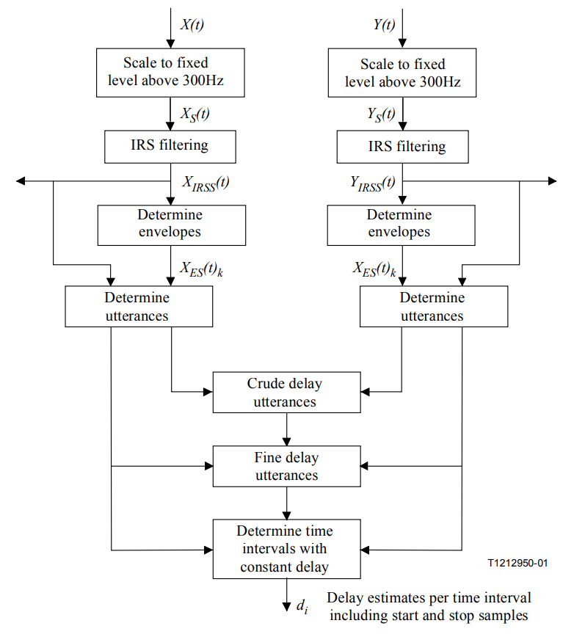
PESQ - level and time alignment
Calculation of the total gain of the system. Filtered versions of the original and degraded signal are calculated. These filtered signals are only used to calculate the overall gain. The mean squares of these filtered signals are then calculated and gains are then calculated and applied to match the original X(t) and degraded Y(t) signals to a constant target level. The result is scaled input and output signals X_{S}(t) and Y_{S}(t)
IRS filtering. It is understood that hearing tests are carried out using the IRS (Intermediate Reference System). The IRS filter emulates the transfer characteristic of a narrowband device. The perceptual model of human evaluation of speech quality must take this into account in order to model the signals that a subject would actually hear. Therefore, IRS-like versions of the original and degraded speech signals are computed. PESQ does this by applying an FFT, filtering in the frequency domain with a pixel-by-bit linear response comparable to the IRS response, followed by an IFFT. The result is filtered versions of the X_{IRSS}(t) and Y_{IRSS}(t) scaled signals X_{S}(t) and Y_{S}(t). These filtered signals are used in temporal mapping and in the perceptual model.

Slide 16
PESQ - level and time alignment
Temporal matching. The temporal mapping provides the perceptual model with temporal delay values ​​so that the model can compare the corresponding parts of the original and degraded signal. This is done in several steps:
Using the scaled signals X_{S}(t) and Y_{S}(t), the values ​​X_{ES}(t)_{k} and Y_{ES}(t)_{k} are calculated. They are defined as Log(MAX(E(k)/E_{thresh}, 1)), where E(k) is the energy in a 4 ms frame k and E_{thresh} is the speech energy threshold determined using the speech activity detector. Between the calculated values ​​X_{ES}(t)_{k} and Y_{ES}(t)_{k} and the scaled signals X_{S}(t) and Y_{S}(t) there is a cross-correlation for a rough estimate of the delay between them (with an approximate resolution of 4 ms).
Since perceptual models are sensitive to temporal shifts, it is necessary to calculate the exact element-by-element offset value. This is done as follows: in each frame, the cross-correlation between the original and the degraded signal after alignment from the previous paragraph is calculated, the maximum of the correlation is a marker of the alignment guarantee in each frame. The histogram of delays, weighted by the assurance marker, is then evaluated. This histogram is smoothed by triangular window convolution. The histogram maximum index gives the final delay estimate. The maximum of the histogram divided by the sum before convolution is the assurance marker (0 - no confidence, 1 - complete confidence). The final result of this item is the delay value and the probability of this value for each phoneme. Given the known start and end points of the phoneme, this allows the perceptual model to determine the delay in each frame.
Taking into account the delay values ​​and the probability of these values, the speech is divided into phonemes. This process is repeated several times in order to get the parts in which the probability value is the highest. Ultimately, the number of time slots is equal to the number of delay changes.
After applying the perceptual model, the parts with the greatest perturbations (above the threshold value) are identified and compared again using cross-correlation.

Slide 17
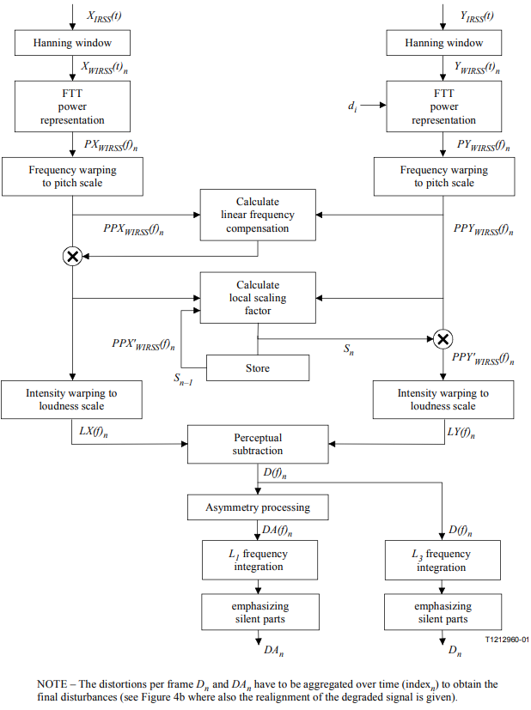
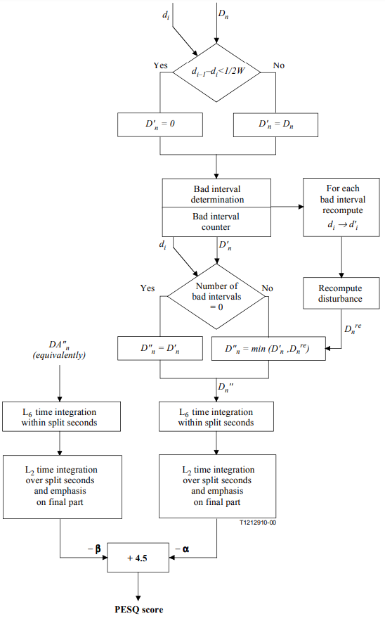
PESQ - perceptual model

Slide 18
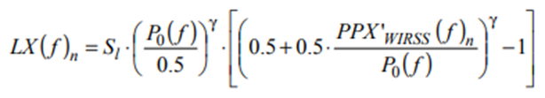
PESQ - perceptual model
The perceptual model is used to calculate the distance between the original and degraded signals (PESQ value). This can be done using a monotonic function to get the MOS score prediction for a given test. PESQ values ​​are marked on a MOS-like scale, in most cases the values ​​are in the range from 1.0 to 4.5).
Precalculation of constants. First you need to get certain constant values ​​and functions. Those that depend on the sampling rate are calculated for 8 and 16 kHz.
FFT window size: PESQ translates time signals into the time-frequency domain using a windowed FFT with a Hann window of 32 ms. For 8 kHz this corresponds to 256 samples per window, and for 16 kHz this corresponds to 512 samples, with an overlap of 50%.
Absolute threshold of hearing: the absolute threshold of hearing P0(f) is interpolated so that its values ​​are located in the center of the corresponding bars on the bark scale. These values ​​are stored in an array and used in the Zwicker loudness formula:
where PPX'_{WIRSS}(f)_{n} will be defined below.
Energy scaling factor: this is an arbitrary gain constant resulting from a time-frequency analysis. This constant is calculated using a 1 kHz sine wave with an amplitude of 29.54 (40 dB SPL) converted to the frequency domain with a 32 ms windowed FFT and at an operating sample rate (8 or 16 kHz). The discrete frequency axis is converted into a bark scale. The peak amplitude of the spectrum on such a scale (called "pitch power density") should be equal to 10,000 (40 dB SPL). The latter is ensured by multiplying the spectrum by a constant, the energy scaling factor Sp.
Loudness scaling factor: The same reference tone (the sinusoid from the previous point) at 40 dB SPL is used to calibrate the psychoacoustic loudness scale (in Sons). After converting to a bark scale, the intensity axis is converted to a loudness scale using the Zwicker formula based on the absolute threshold of hearing. The integral of the loudness density on the bark scale should give a value of 1 Son. The latter is provided by multiplying the spectrum by a constant - the loudness scaling factor Sl.

Slide 19
PESQ - perceptual model
IRS filtering. As stated above, it is understood that eavesdropping is done using the IRS. The necessary pre-processing has already been done in the previous steps.
Calculation of active speech intervals. If the original and degraded speech begin or end with large intervals of silence, this may affect the calculation of certain distortions. Therefore, quiet parts at the beginning and end of files are evaluated. To determine the beginning and end of the active interval, the sum of five consecutive sample values ​​at the beginning and end of the source file must exceed 500. To reduce calculation cycles and the amount of data stored, some calculations are performed only with an active interval.
Windowed FFT. PESQ uses a windowed FFT with a window size of 32 ms and a windowed overlap of 50%. The energy spectrum - the sum of the squares of the real and imaginary parts of the complex FFT components - is stored in separate arrays for the original and degraded signal. The phase is discarded and all calculations are done with energy values ​​only. Let's denote them PPX'_{WIRSS}(f)_{n} and PPY'_{WIRSS}(f)_{n}. The starting points of the windows in the degraded signal are shifted according to the delays. If the delay increases, a part of the degraded signal is excluded from processing, if it decreases, the parts are repeated.

Slide 20
PESQ - perceptual model
Calculation of loudness densities. After partial compensation for filtering and short-term gain variations, the original and degraded pitch power densities are converted to the Sonah loudness scale using Zwicker's law:
where P₀(f) is the absolute threshold and S_{l} is the loudness scaling factor defined above. Above 4 Bark, the Zwicker exponent γ is 0.23. Below 4 Bark, the Zwicker exponent slowly increases due to the so-called cumulative effect. As a result, we obtain two-dimensional arrays LX(f)_{n} and LY(f)_{n} – loudness densities.
Calculation of distortion density. The difference between the distorted and original loudness densities is calculated. When this difference is positive, noise-like components are added. When negative, part of the components of the original signal is omitted. Such a difference array is called the original distortion density. For each time-frequency cell, the minima of the original and distorted loudness densities are calculated. These lows are multiplied by 0.25. The corresponding two-dimensional array is called a mask array. The following rules apply to each time-frequency cell:
If the original distortion density is positive and greater than the corresponding masking array value, the mask value is subtracted from the density value.
If the original distortion density lies within the amplitude fluctuations of the mask value, then the density value will be reset to zero.
If the original distortion density is less than the corresponding mask value with a "-" sign, then the mask value is added to the density value.
Ultimately, the values ​​of the initial distortion density shrink to zero. This means a "dead zone" before the current time-frequency cell is perceived as corrupted. This simulates the process of masking small fluctuations in the presence of loud signals. As a result, we obtain the distortion density as a function of time (frame number) and frequency, D(f)_{n}.

Slide 21
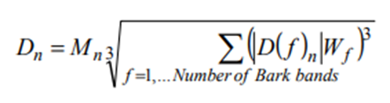

PESQ - perceptual model
Element-wise multiplication by the asymmetry factor. The effect of asymmetry is that when a codec distorts the input signal, it becomes very difficult to represent the new time-frequency component as a variation of the input signal. Thus, the output signal will be represented as the sum of two different entities - the input signal and distortion, which leads to a clearly audible distortion. When the codec omits the time-frequency component, the resulting output signal cannot be decomposed in the same way, and the distortion becomes less significant. This effect is modeled by calculating the asymmetric distortion density DA(f)n in each frame. It is obtained by multiplying the distortion density D(f)n by the asymmetry factor. This factor is equal to the ratio of the distorted and initial energy density of the fundamental tone, normalized to 1.2. If the asymmetry factor is less than 3, then it will be reset to zero, if it exceeds 12, then it is cut off by this value. Thus, only those time-frequency cells remain for which the distorted energy density of the fundamental tone exceeds the original one.
Frequency aggregation of distortion densities and emphasis on the quiet parts of the original. The distortion density D(f)n and the asymmetric distortion density DA(f)n are summed along the frequency axis using two different Lp-norms (Lebesgue space norm of order p) and weighting over quiet frames:
where M_{n}=1/(E₀+C)^{0.04}, E₀ is the energy of the initial frame, C is an arbitrary constant. This leads to the selection of distortions that occur during periods of silence in the original fragment of speech, and W_{f} is a vector of constants proportional to the width of the corresponding Bark band. After multiplication, the distortion values ​​are capped at 45. These aggregated values ​​of D_{n} and DA_{n} are called frame distortions.

Slide 22
PESQ - perceptual model
Zero frame distortion for frames with a significant reduction in latency. If the delay in the distorted signal decreases by more than 16 ms (half of the window), then the strategy with the repetition of parts of the signal changes. It was found that in such cases it is preferable to ignore frame distortions in the calculation of the objective speech quality. When this happens, frame distortion is nullified.
Re-matching "bad" intervals. Consecutive frames with frame distortion above a certain threshold are called "bad". In some cases, an objective measure predicts significant distortion in the minimum number of "bad" frames, which occurs due to incorrect determination of delays at the preprocessing stage. For such intervals, new delay values ​​are estimated by maximizing the cross-correlation between the absolute original and absolute degraded signals, taking into account the delays calculated in preprocessing. When the maximum cross-correlation is below the threshold, the decision is made that the intervals are matched for noise and are no longer "bad", and their processing at this stage stops. Otherwise, the frame distortion for "bad" intervals is recalculated, and if the new value is less than the previous one, then it replaces it.
Aggregation of distortions by fractions of a second. Frame distortion and asymmetric frame distortion are aggregated over 20 frames (approximately 320 ms) using L6-norms.
Aggregation of distortions along the length of the speech signal. The aggregated values ​​from the previous step are aggregated again over the length of the active speech interval using L2-norms. The higher order of norms for aggregation by fractions of a second is due to the fact that when the fractions of a second are distorted, this fraction loses its meaning, while if the first sentence in the speech file is distorted, then the quality of other sentences remains unchanged.
PESQ value calculation. The final value of PESQ is a linear combination of the average distortion value and the average asymmetric distortion value. PESQ values ​​range from -0.5 to 4.5, although in most cases the output range will be a MOS-like listening quality value, from 1.0 to 4.5.

Slide 23
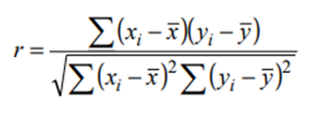

Comparison between PESQ and subjective scores
Subjective scores are influenced by many factors, such as the behavior of individual participants or the context of the experiment. Therefore, there is a need for regression before direct comparison. Regression is monotonic to preserve information and is commonly used to correlate an objective PESQ with a subjective score. A good objective measure should be highly correlated with many subjective scores if the regression is applied separately to each, and in practice the PESQ has an almost linear regression when viewed in terms of MOS.
The preferred regression method for calculating the correlation between PESQ and MOS that was used to validate PESQ uses a third-order restricted monotonic polynomial. In most cases, the standard MOS is used as the metric, so the regression is computed between that MOS and the average of at least four PESQ examples. To compare objective and subjective scores, the subjective MOS must first be calculated using standard methods.
Differences between PESQ and subjective metrics can be calculated using the correlation coefficient. This is done on averaged and matched metrics. The correlation coefficient is calculated using the Pearson formula:
where x_{i} is the MOS value for the ith experiment, x ̅ is the average MOS across all experiments, y_{i} is the matched average PESQ for the ith experiment, and y ̅ is the average predicted MOS over all i experiments.
Regression matching eliminates systematic biases between objective and subjective metrics by minimizing the mean square of residual errors:
For the experiments conducted by the PESQ developers, the average correlation was 0.935, and the average residual error was less than 0.25 MOS in most of the experiments.

